Slide 1
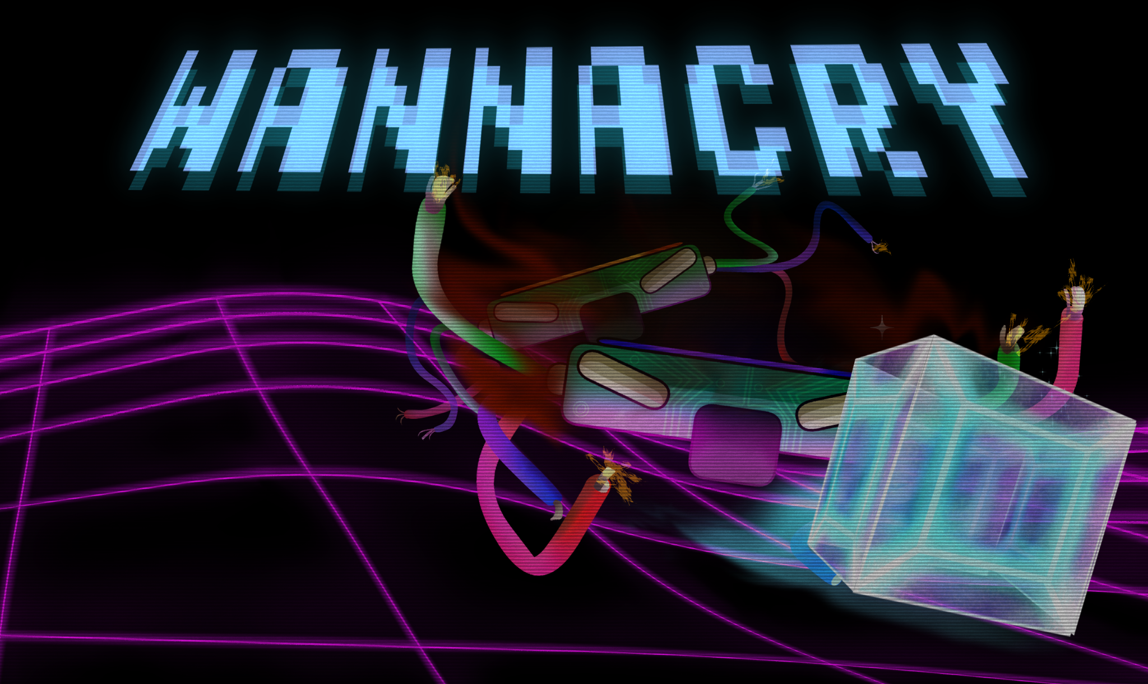
A game brought to you by FARCRY
A game brought to you by F.A.R.C.R.Y

Slide 2
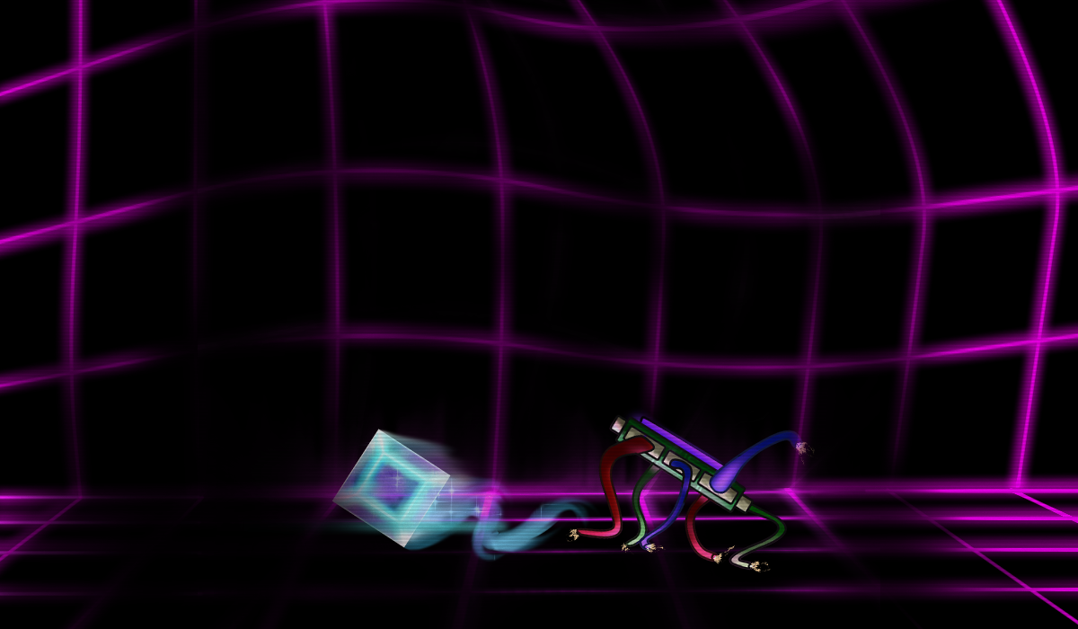
Introducing WannaCry
2D, Top Down Reaction-based Puzzle Game.
High Stakes Gameplay.
Contains Strategic Elements.
Exciting Cyberspace/Digital Aesthetic.

Slide 3
Understanding WannaCry
01
Think of it as Pac-man meets Hot-Potato
02
Each player has a turn with the virus. It is their job to transmit the virus as fast as possible, or evade the opponents virus by any means necessary.
03
Our project is engineered to accommodate our bots to play the game as intelligently as possible.
Notes:
Each player has a turn with the virus. It is their job to transmit the virus as fast as possible, or evade the opponents virus by any means necessary.

Slide 4



Target Audience
Tech Enthusiasts.
Competitive Gamers
Casual Gamers

Slide 5
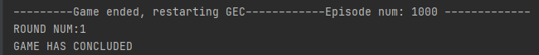
What makes our game AI special?
A* | Q-learning with state proximity measure | Deep Q Network with Memory Replay | Actor-critic algorithm (inspired by DeepMind)
No cheating or game mechanics changes to increase or decrease the challenge
Organic difficulty progress
Win or lose dependent on your actions alone
Notes:
WannaCry contains many AI structures.
Our game (unlike most) does not cheat to increase or decrease the challenge.
AI Structures such as Q-Learning and Deep Q-Learning progress the difficulty organically.
Provides a satisfying experience, as you win or lose dependent on your own actions alone.

Slide 6
Reinforcement Learning (DQN, A2C)
MDP
State
Action
Reward
Highlights
Noticeable patterns
User training with developer mode
Notes:
WannaCry contains many AI structures.
Our game (unlike most) does not cheat to increase or decrease the challenge.
AI Structures such as Q-Learning and Deep Q-Learning progress the difficulty organically.
Provides a satisfying experience, as you win or lose dependent on your own actions alone.

Slide 7

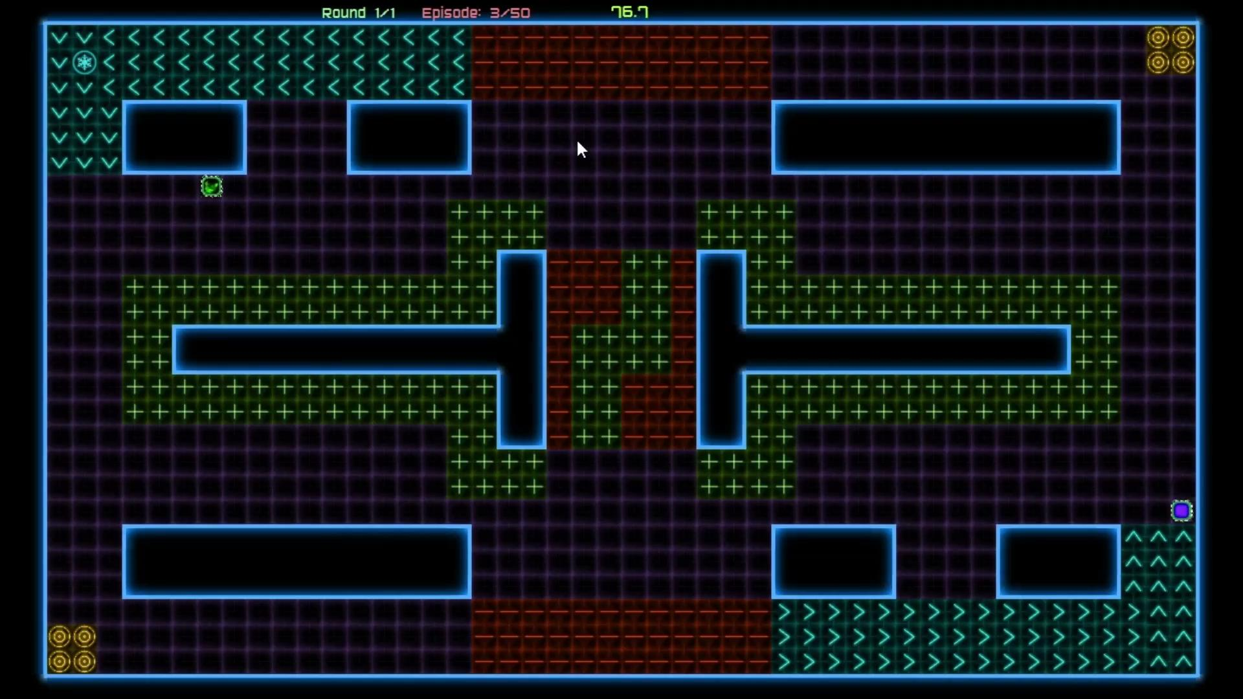

Slide 8
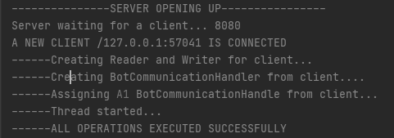
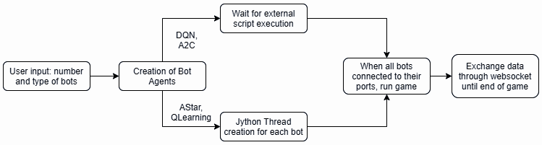
How do our bots make intelligent decisions?
Notes:
Establishes communication with our bot, giving it the initial information about the game stage.
Websocket receives data packets that contain the updated state of the game.
Python implementation returns an action that is sent back to our game engine.

Slide 9
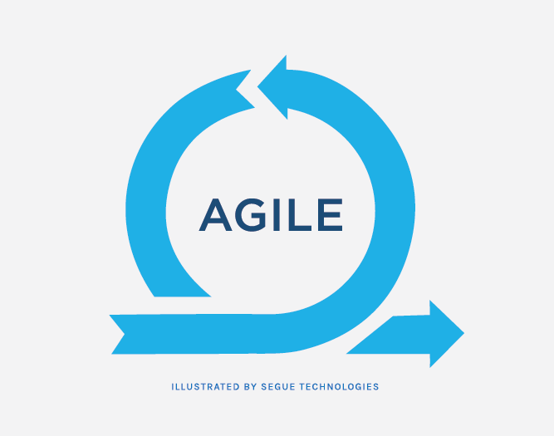
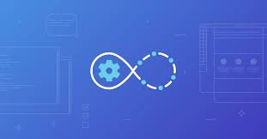
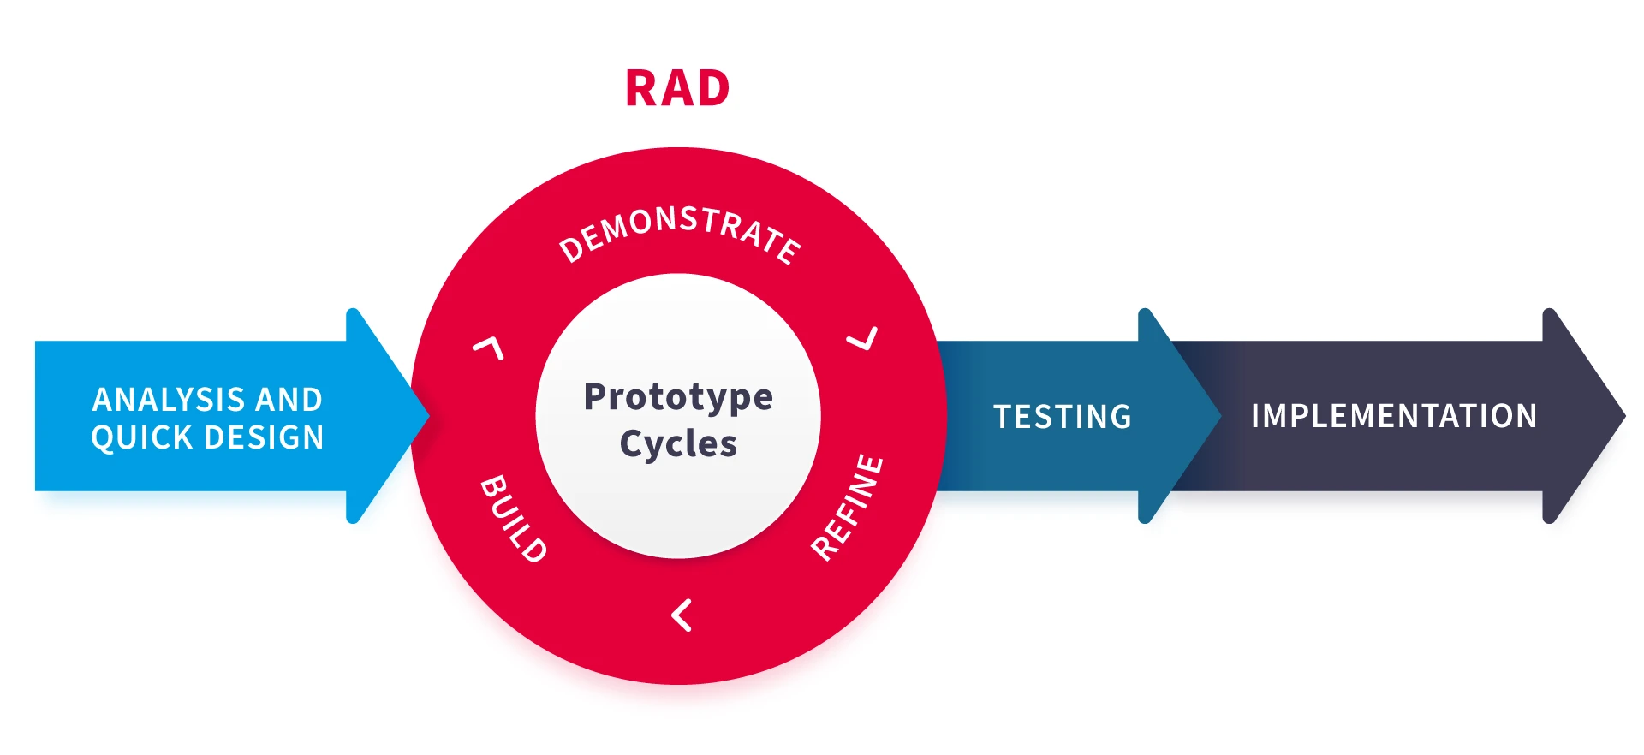
Software Engineering Processes
Agile Development
Incremental
Iterative
Pair-Programming
Continuous Integration
Rapid Application Development
Notes:
Great game, not only because of architecture, but because of software engineering practices.
Used some of agile.
For instance, I remember that Ben and I used pair programming where one of us would code and the other would proofread when designing the map.
Master branch always had working product.
Not much time so used RAD.
RAD needs modularisation.
Vlad comes in.

Slide 10
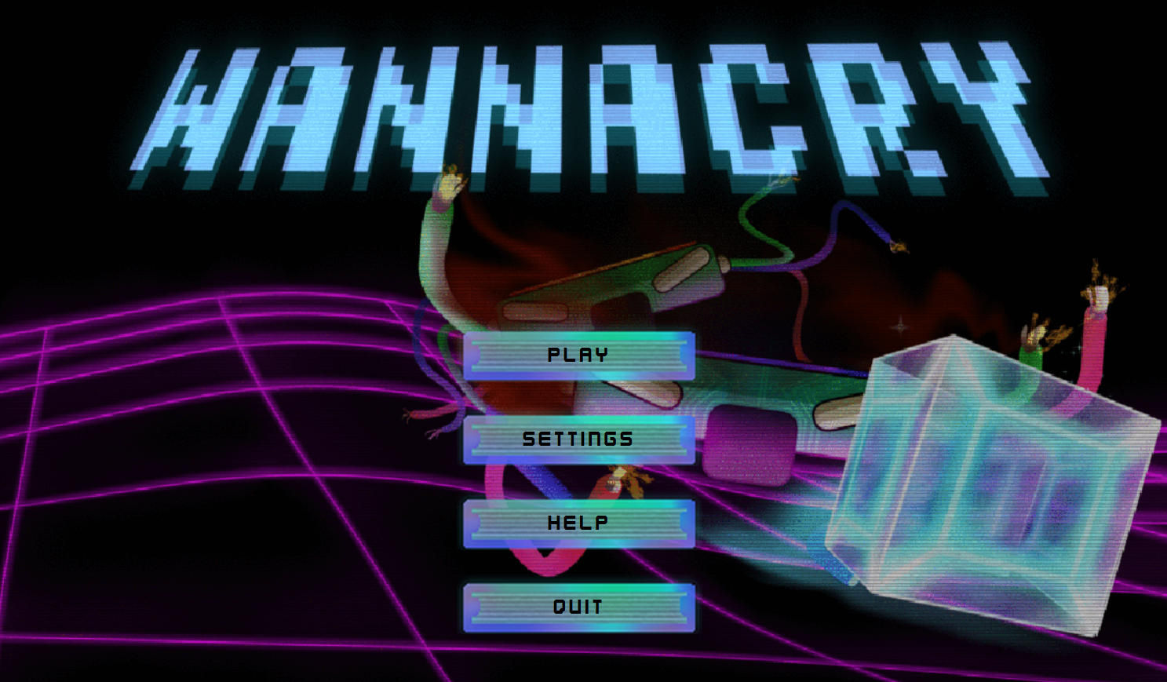
Model-View-Controller Architecture
Modular design - implementation of new features (Gameplay or visual) were efficient.
UI components did not interfere with the gameScene
Separating the game logic controller and the view controller meant that we could more efficiently train our AI algorithms to improve at our game.

Slide 11
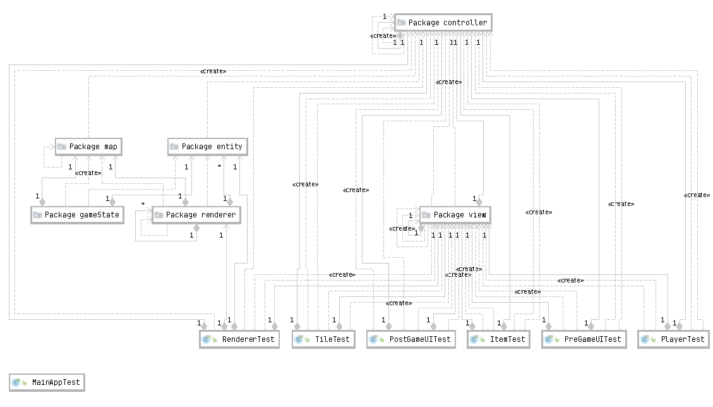
Strong Testing
Created extensive testing plan for Java and Python implementation
Test driven development, structured our progress
Exhaustive, Erroneous, Edge Case Testing, meant code remained strong after implementation.

Slide 12
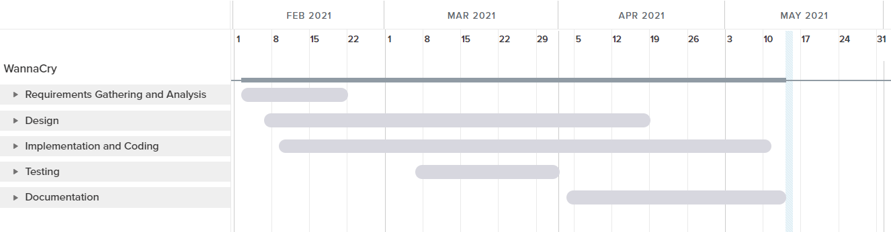
Project Timeline
Notes:
Shown as a simplistic Gantt chart.
Split into categories for easier understanding.
RAD approach is shown among different categories.
Detailed diagram in the report.

Slide 13
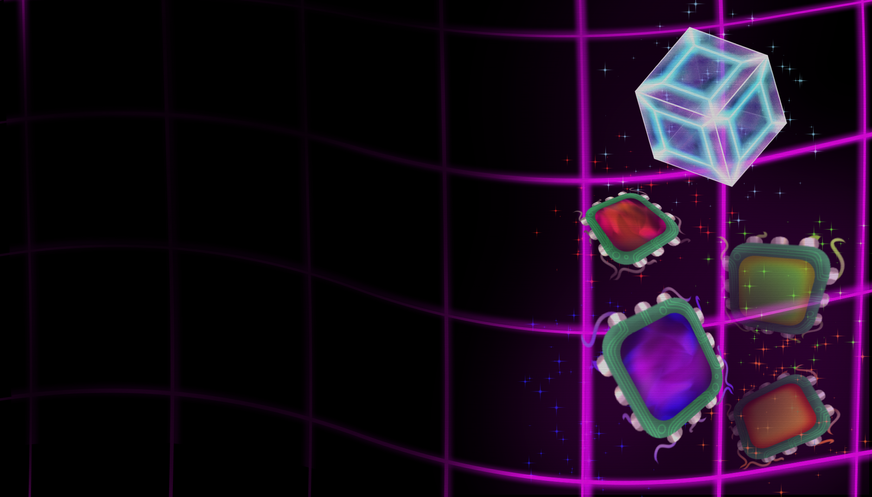
Thank you!
Please feel free to ask any questions, and we hope that our game makes you WannaCry with joy.

